Slide 1
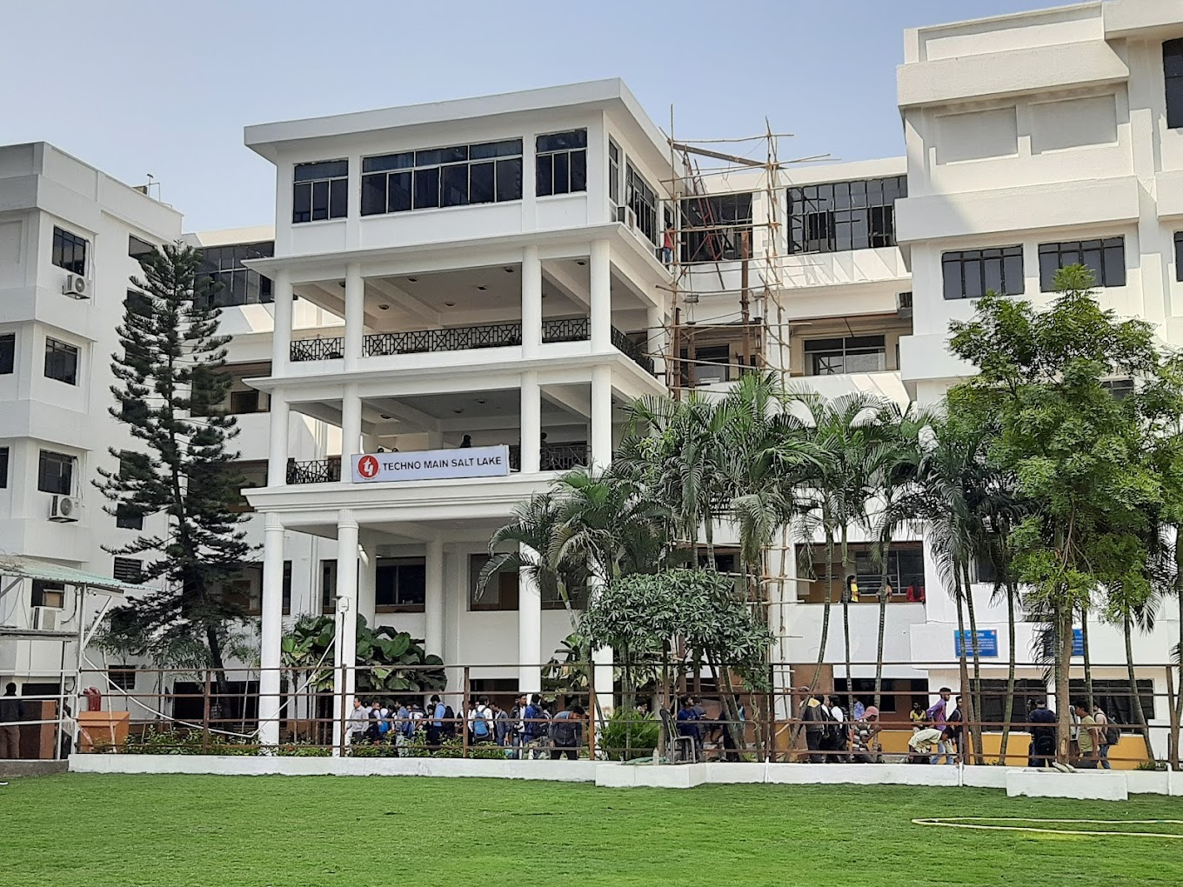
My College Life
A glimpse into my journey
By ANANYA DEY (DCST)
Registration no. d232431093

Slide 2
Introduction
College life has been a transformative experience filled with learning, friendship, and growth.

Slide 3
Academics
From lectures to lab work, academics have played a major role in shaping my college journey.

Slide 4
Friends and Social Life
College wouldn't be the same without the friends I made and the fun we had at various events and gatherings.

Slide 5
Extracurricular Activities
From sports to cultural fests, extracurriculars helped me explore my passions and talents.

Slide 6
Memorable Moments
Whether it was a surprise birthday party or a last-minute study session, these moments made college unforgettable.

Slide 7
Conclusion
College life has been a journey of self-discovery, challenges, and countless memories.

